Slide 1

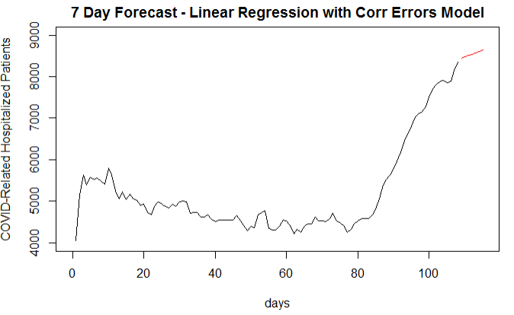

California
MLR Candidate Model
7-Day ASE
173,607
AIC w/o trend: 1,436
AIC with Trend: 1,433
Notes:
Josh Notes: 17 sec
The first multivariate models were built with linear regression with correlated errors. This is the one week forecast for California using the average of the last 7 days of New cases and the trend component as a predictors. The MLR model was examined both with and without time as a variable, and although adding it provided marginal benefits according to an AIC comparison, we included it since prior analyses were predicated on the clear recent increasing trend.

